Slide 1
Purification of the P66 Outer Membrane Protein of the Bacterium Borrelia burgdorferi
Space Grant Symposium Presentation
Christopher Ramirez
Debra Hansen and Petra Fromme
4/17/21

Slide 2
Background

Slide 3
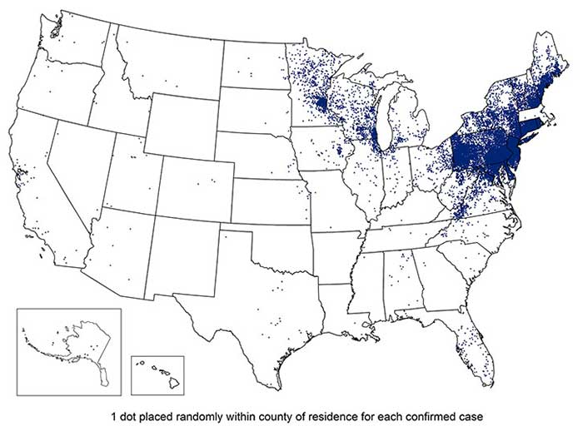
What is Lyme disease?
Most common tick-borne illness in US
(estimated ~300,000 cases/year)
Symptoms of untreated infections include:
Arthritis (30%)
Neurological disorders (10-15%)
Cardiac conditions (1-2%)
Healthcare costs total more than $1 billion per year
Some patients can develop post-treatment Lyme disease with symptoms such as pain, fatigue, and neurological dysfunction for months or even years following infection
No known treatment
Map of 2018 reported Lyme disease cases.
Lyme Disease Data and Surveilance, 2018. Center for Disease Control. https://www.cdc.gov/lyme/datasurveillance/index.html

Slide 4
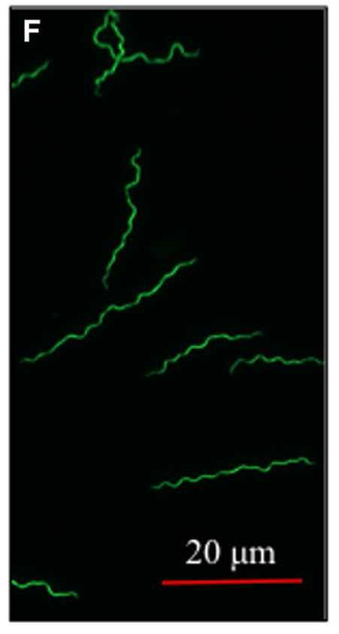
Cause of Lyme disease – Borrelia burgdorferi
Lyme disease is caused by Borrelia burgdorferi (B.b.)
Bacterium that lives in the midgut of Ixodes ssp. ticks
B.b. can be spread to humans and other mammals through the tick’s saliva when it feeds on their blood
High passage Bb strain B31A cells expressing PfliD-GFP from plasmid pJSB275.
Zhang et al 2019 Molecular Microbiology 111, 1652–1670, doi:10.1111/mmi.14243

Slide 5
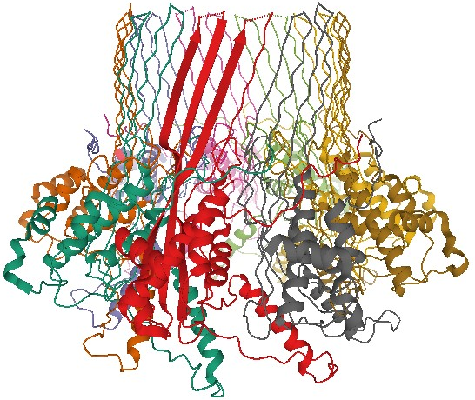
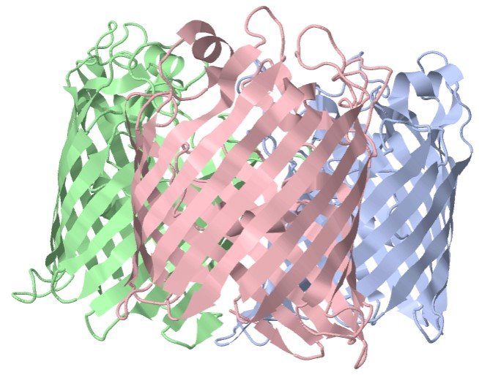
What is P66?
66kDa outer surface protein that has recently been investigated as a possible target for Lyme disease treatments
Outer surface proteins medically significant, but hard to work with
Channel studies of P66 suggest that P66 forms an structure of 8 proteins while in the outer membrane
Aids B.b. in binding to structures present in heart and ear tissue in humans
Appears to be vital to establishing a Lyme disease infection in humans, as B.b. is more common following tick feeding
The CsgG protein of E. coli, speculated to be structurally similar to P66.
The OmpF protein of E. coli, another possibly similar structure to P66.
Protein Data Bank. http://www.rcsb.org/

Slide 6
Purpose of Project
To develop a method for large-scale purification of the P66 protein from the bacteria Escherichia coli in order to support structural studies
Previously, one of the largest obstacles to purifying P66 was getting the protein in the outer membrane of E. coli
Past efforts have failed due to the instability of the recombinant protein produced in E. coli
Recent experiments using the PelB signal sequence to direct P66 to the outer membrane have met with success. This project hopes to:
Use a DNA sequence containing only the PelB signal sequence and the P66 protein to produce P66 in the outer membrane of E. coli
Optimize growth conditions until sufficient for protein purification

Slide 7
Experimental

Slide 8
Proteins Expressed
Protein from Robertson et al. 2019 Sci Rep:
PelB_{ss}
His₁₀
MBP
TEV
P66₂₂₋₆₁₈
Proteins expressed in this experiment:
kDa kDa –ss
69.1 66.9
68.0 65.8
PelB_{ss}
P66₂₂₋₆₁₈
His₈
“PelB-P66-His”
PelB_{ss}
P66₂₂₋₆₁₈
“PelB-P66”

Slide 9
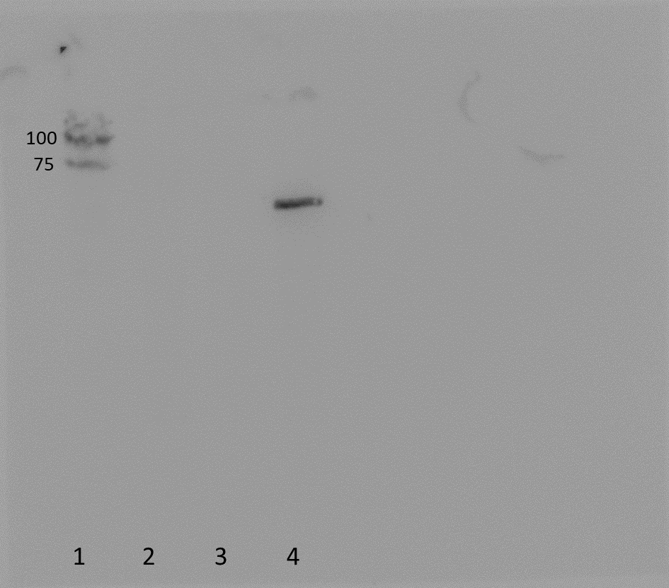
His-tagged P66 is Present When Grown in the Omp8 Cell Line
After transforming E. coli cells with plasmid DNA from previous slide, cells were grown, then run in an SDS-PAGE. This was used to perform an Anti-His Western to verify that P66 was present in the cells.
Anti-His Western
Lane and Sample
Molecular weight markers
PT7-PelB Empty Vector/Negative Control (Total Protein)
PelB-P66 (Total Protein)
PelB-P66-His (Total Protein)

Slide 10
P66 Can Be Expressed in the Outer Membrane of the Omp8 Cells
Anti-His Western
A crude membrane separation was performed on E. coli cells in the previous slide, and a Western blot using anti-His antibodies was done on the resulting membrane fractions.
100
75
50
Lane and Sample
Molecular weight markers
GFP Positive Control
PelB-P66-His Sonicated Cells
PelB-P66-His Cell Debris
PelB-P66-His Cytosol
PelB-P66-His Inner Membrane
PelB-P66-His Outer Membrane
Molecular weight markers
37
25
20
1
2
3
4
5
6
7
8

Slide 11
Optimization of Omp8 P66 Growth Conditions
250
Coomassie Stain
Lane and Sample
Molecular weight markers
1mM IPTG Sonicated Cells
1mM IPTG Cell Debris
1mM IPTG Cytosol
1mM IPTG Inner Membrane
1mM IPTG Outer Membrane
0.5 IPTG Sonicated Cells
0.5 IPTG Cell Debris
0.5mM IPTG Cytosol
Molecular weight markers
150
100
75
50
37
25
20
15
In an attempt to increase P66 expression, cells were grown at varying different conditions.
10
1
2
3
4
5
6
7
8
9
10
250
150
Coomassie Stain
Lane and Sample
Molecular weight markers
0.5 IPTG Inner Membrane
0.5 IPTG Outer Membrane
0.25 IPTG Sonicated Cells
0.25 IPTG Cell Debris
0.25 IPTG Cytosol
0.25 IPTG Inner Membrane
0.25 IPTG Outer Membrane
Molecular weight markers
100
75
50
37
25
20
15
10
1
2
3
4
5
6
7
8
9

Slide 12
Conclusions and Future Work
P66 can be brought to the outer surface of bacteria using the PelB signal sequence
Need to do Western to confirm optimization of growth
Need to confirm proper folding of His-tagged proteins
If folded incorrectly, then move to untagged
Work on purification techniques

Slide 13
Acknowledgements
Thank you to my mentors Debra Hansen and Petra Fromme for their constant advice and direction throughout the project. Graduate students Emily Kaschner, Matthew Goode, and Rebecca Jernigan and Postdoc Nirupa Nagaratnam all also helped tremendously by providing training on various laboratory techniques. Finally, thank you to Space Grant, who helped fund a portion of this project.

Slide 14
Thank You

